Slide 1
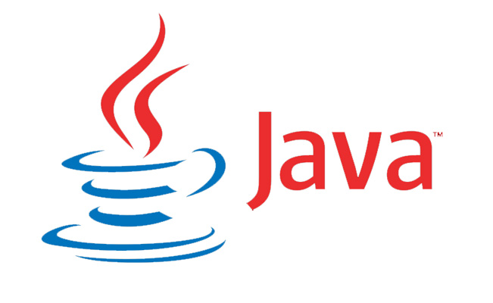
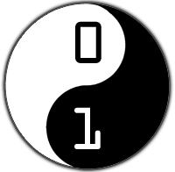
Coder Dojo: Java Intro

Slide 2
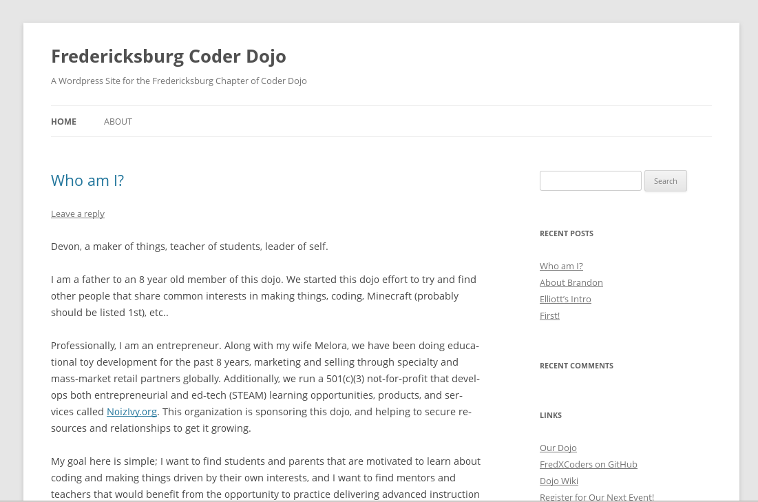
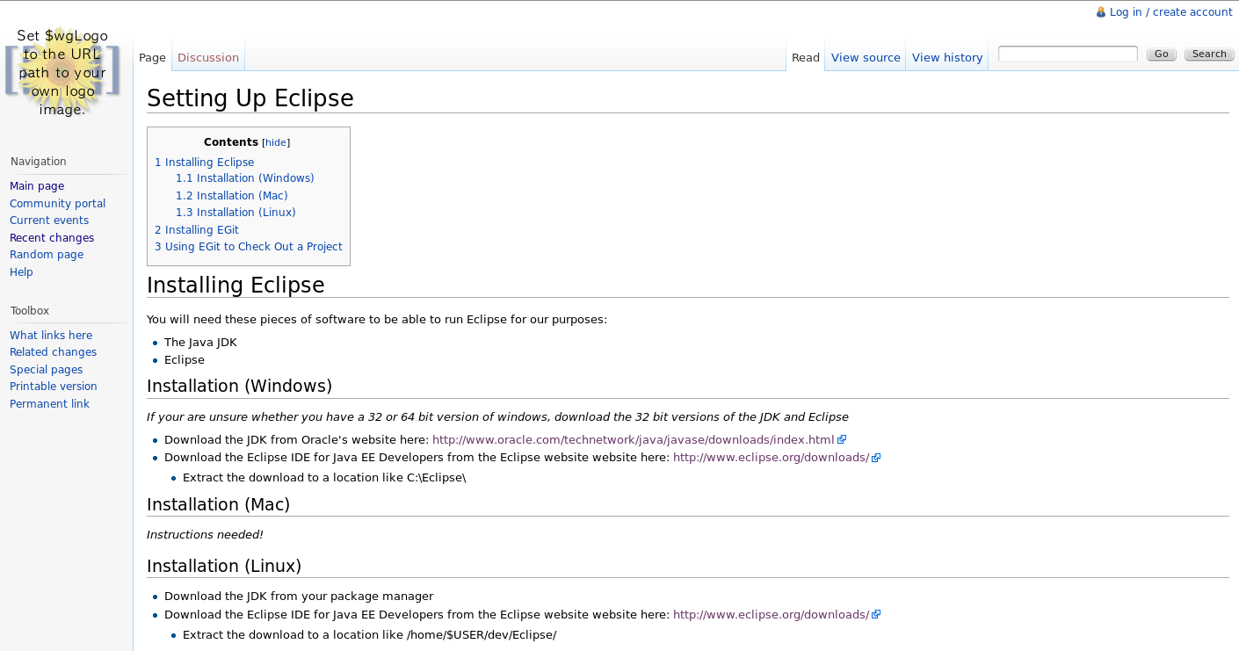
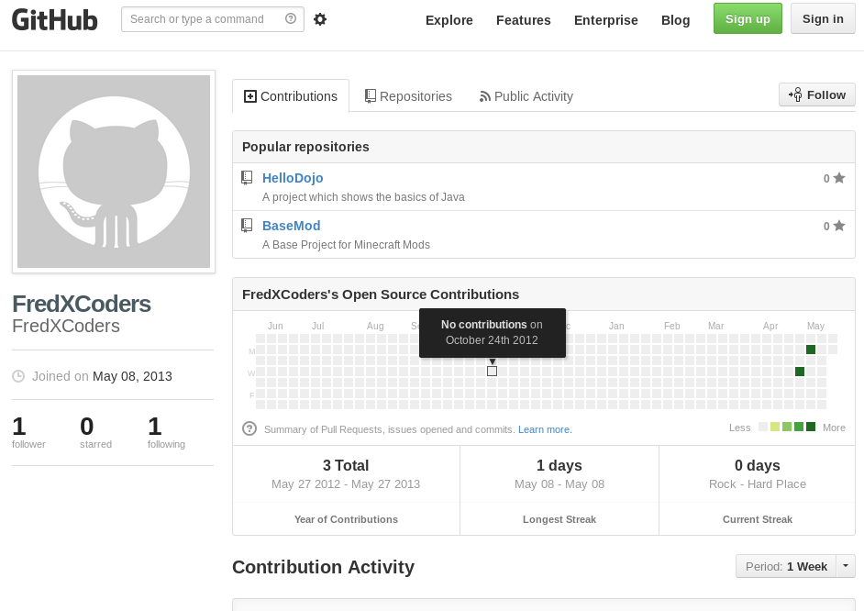
Dojo Site - fredxcoders.com
Wiki
Blog
GitHub
Notes:
Wiki: software (think wikipedia) that lets people create and edit pages. This will hold our documentation (how to do things).
Blog: an online journal. We'll put updates for the group, homework, and interesting articles to read here.
GitHub: a repository, or central place to keep our code. We'll keep track of the code for our projects here.

Slide 3
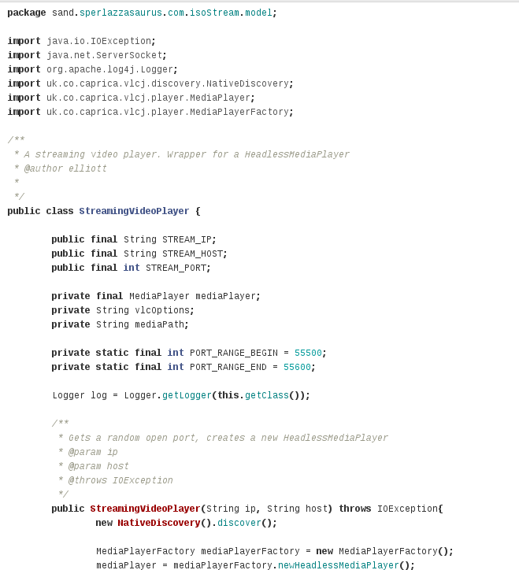
Source Code
Notes:
Source Code: Human readable instructions which are compiled into code a machine can read. You may not be able to “read” this yet, but you will!

Slide 4
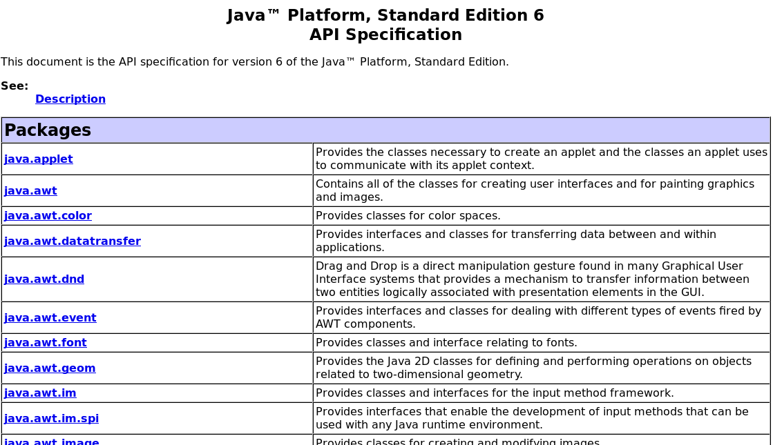
APIs
Notes:
APIs: (application programming interface) an “official” way for programs to interact with each other. Minecraft does not have official APIs for us to use in making mods, but the modding community has come up with some “unofficial” APIs which we will be using as well as decompiling the Minecraft code.

Slide 5
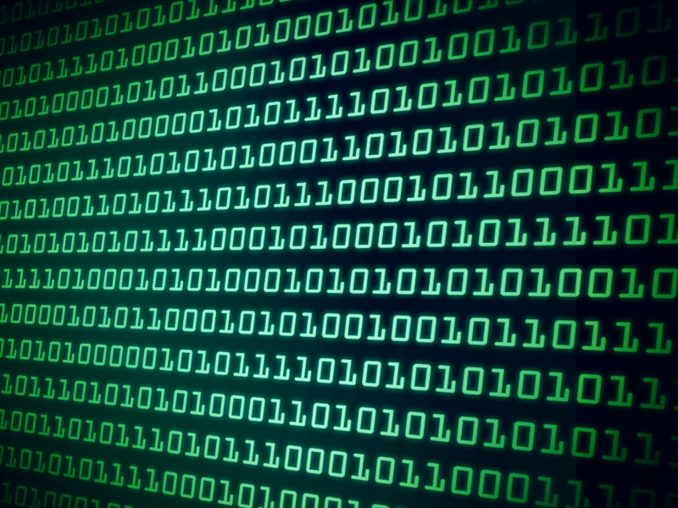
Code Compilation
Notes:
Code Compilation is the process of taking our human readable code and turning it in to code which a computer can understand. Machines don't need all of our fancy English language!
Code Decompilation is the opposite: turning code a machine can read into code a human can read. We'll be doing this with Minecraft code!

Slide 6
Legality vs Ethics
- Participating in Coder Dojo!
- Pushing a random person to the ground
- Saying you cleaned your room when you haven't
- Steal a loaf of bread to feed your starving family
Legal
Ethical
Notes:
Legal: permitted by law; Ethical: what is right and wrong(can depend on a situation)
+Legal, +Ethical: Participating in Coder Dojo!
-Legal, -Ethical: Pushing a random person to the ground
+Legal, -Ethical: Saying you cleaned your room when you haven't
-Legal, +Ethical: Steal a loaf of bread to feed your starving family
What does this have to do with Minecraft?
Minecraft is protected by copyright and other laws which means that it could be illegal to make changes. Luckily Notch has said:
“I ... know how wonderful mods are for games. We decided to just let it happen, and I’m very happy we did. Mods are a huge reason of what Minecraft is.” -Notch, 2012, Reddit
This means we can develop and distribute our Minecraft Mods
(There are some rules to follow: don't distribute Minecraft source, don't create the ability to play without paying for the game, don't break Minecraft's Terms of Service)

Slide 7
Java
In Java we create objects(classes) to do things.
Objects have “methods” and “variables”
Variables hold information
Methods do things

